Slide 1

Notes:
Good morning/afternoon and welcome to the third presentation in the What Would You Do? Presentation Series.
This presentation series explores areas of risk in real estate practice, with each presentation focusing on a different area of risk.
Today’s presentation explores the risks around conflicts of interest.
To do so, we will follow a real estate professional through a transaction where they may find themselves in a conflict of interest.
We will also review two case studies involving licensees who found themselves in a conflict of interest and discuss how risk could have been mitigated in these scenarios.
The What Would You Do? presentation series is a joint project between the BC Real Estate Association, the Real Estate Council of BC and the Real Estate Errors and Omissions Insurance Corporation.
This provides a 360-degree look at risk management from the perspectives of your professional association, regulator, and insurer.
Ok, let’s get started….

Slide 2

Notes:
This is Dakota.
Dakota is a real estate professional and has been looking for a home for her family for some time.
One of Dakota’s team members has listed this home, and asked Dakota to help with the marketing.
Upon viewing the home, she becomes interested in purchasing it for her family and wants to make an offer.
However, as the home is listed by one of her team members, Dakota recognizes this might present a conflict of interest.

Slide 3

Notes:
If you found yourself in this situation, what would you do?
What might you need to consider before proceeding? (open for discussion)

Slide 4
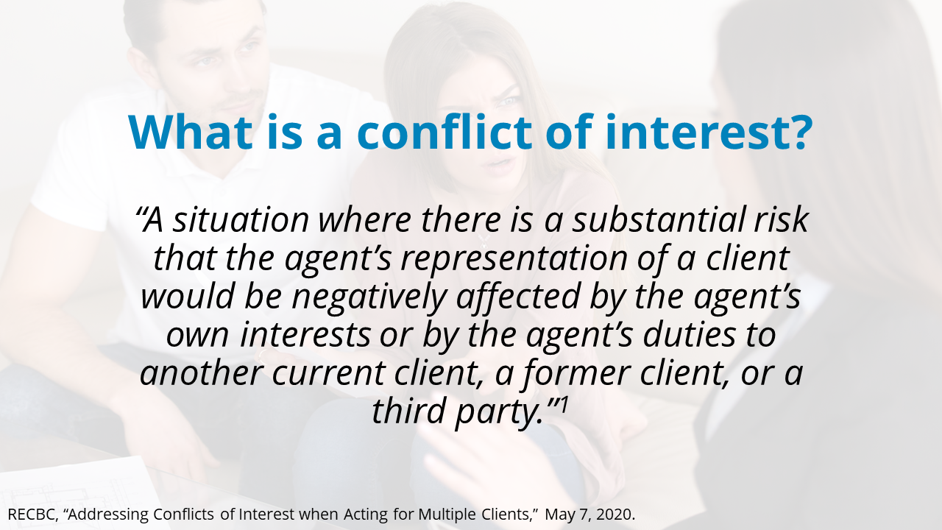
Notes:
Let’s start by defining a conflict of interest.
The Real Estate Council of BC defines a conflict of interest as “a situation where there is a substantial risk that the agent’s representation of a client would be negatively affected by the agent’s own interests or by the agent’s duties to another current client, a former client, or a third party.”

Slide 5
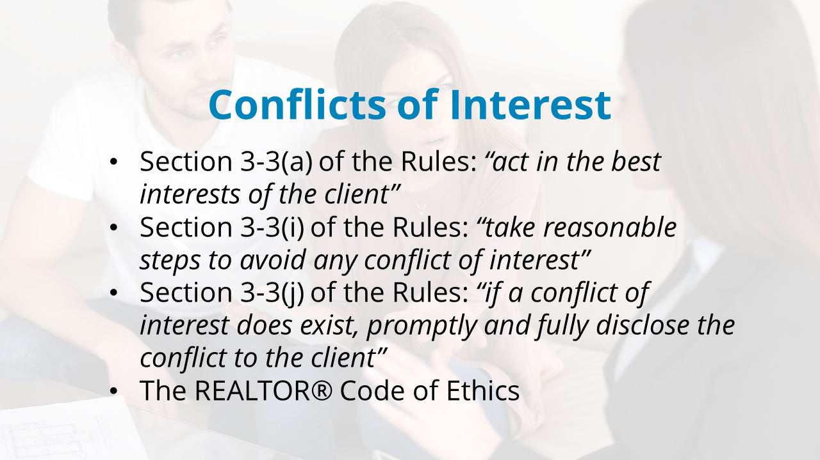
Notes:
Real estate professionals who are engaged by a client to provide real estate services owe certain duties to that client, as mandated by the Real Estate Services Act and the Real Estate Rules:
Section 3-3(a) of the Rules requires licensees to ‘‘act in the best interests of the client,’’
Section 3-3(i) requires licensees to ‘‘take reasonable steps to avoid any conflict of interest,” and
Section 3-3(j) requires licensees to “promptly and fully disclose the conflict to the client, if a conflict of interest does exist.”
In addition to the Real Estate Rules, Realtors must also abide by the REALTOR® Code of Ethics, their board rules and their brokerage policies and procedures.

Slide 6

Notes:
What are some situations where real estate professionals may find themselves in a conflict of interest? (open for discussion)

Slide 7
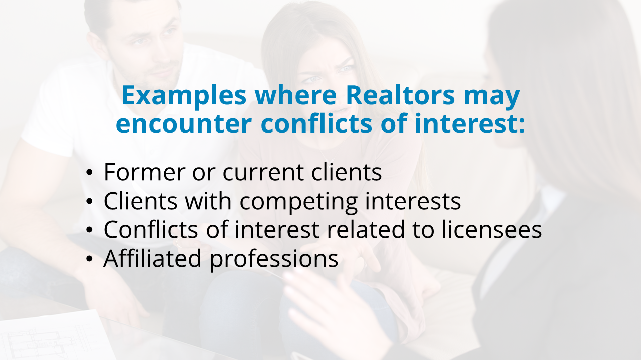
Notes:
As you identified, there are many situations where real estate professionals may find themselves in a conflict of interest.
Some examples include:
Former or Current Clients – For example, where a former client is interested in purchasing one of your current listings.
Clients with Competing Interests – For example, when one client wishes to make an offer on a property you have listed, or two clients are interested in making an offer on the same property.
Conflicts of Interest Related to Licensees – For example, if you are interested in acquiring, either directly or indirectly, or disposing of a property.
Affiliated Professions – For example, when if you are acting as a mortgage broker, developer, etc., and a licensee.
Have you had any personal experiences with these situations or others where a conflict of interest occurred, and how did you handle it? (open for discussion)

Slide 8
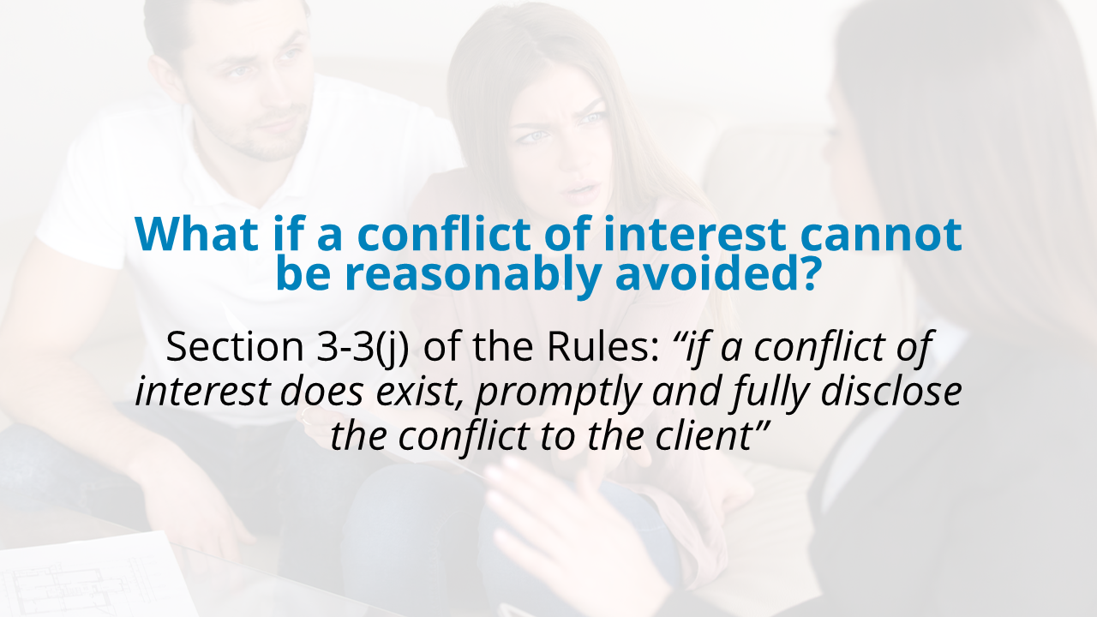
Notes:
In situations where a conflict of interest cannot be reasonably avoided, section 3-3(j) of the Real Estate Rules requires a real estate professional to ‘‘promptly and fully disclose the conflict to the client’’.
A fully informed client may then choose to allow the real estate professional to continue to act in that conflict by modifying or making inapplicable the obligations that can’t be fulfilled because of the conflict.
For example, if you have two current clients interested in purchasing the same property, it is possible – where appropriate and with both parties’ consent – to proceed as a representative of one client.
In this situation, you should refer to section 5-18 of the Rules, which addresses conflicts of interest when acting for multiple clients.
In order for you to continue representing one client in the transaction, you must obtain the consent of both clients to the Agreement Regarding Conflict of Interest Between Clients.
It acknowledges that a conflict exists and outlines your relationship and duties to each party moving forward.

Slide 9
Notes:
Now that we’ve reviewed the rules governing real estate professionals and conflicts of interest, let’s revisit Dakota’s situation.
One of Dakota’s team members has listed this home, and asked Dakota to help with the marketing.
Upon viewing the home, she becomes interested in purchasing it for her family and wants to make an offer.
However, as the home is listed by one of her team members, Dakota recognizes this might present a conflict of interest.
Although the following case studies are different from Dakota’s specific situation, they offer some important insights and fact patterns where real estate professionals have acted in a conflict of interest and how their actions may inform Dakota’s decision.

Slide 10

Notes:
The first case study was provided by the Real Estate Council of BC.
In this case study, we will explore a scenario where a real estate professional offered to loan his clients money to help them purchase a home.
We will discuss where the real estate professional went wrong in this situation and review the disciplinary decisions made by RECBC.
Please note, this scenario occurred before September 2016, under the old rules and disciplinary sanctions.

Slide 11
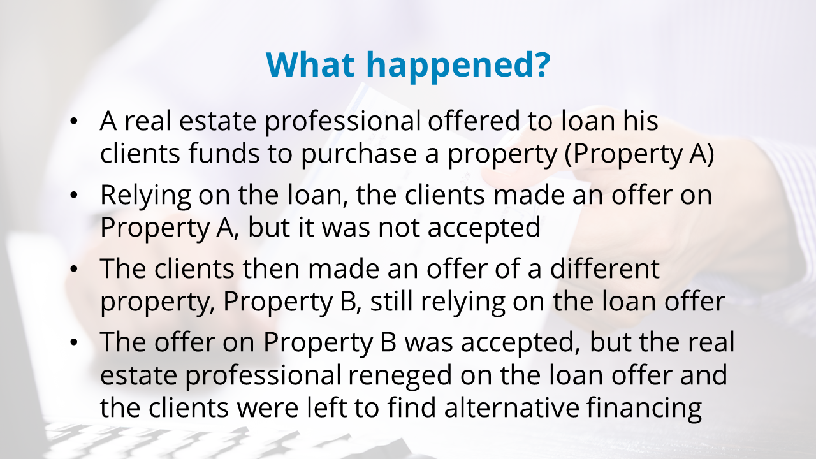
Notes:
In this case study, a real estate professional’s clients were looking to sell their existing home and find a new home.
At the suggestion of the real estate professional, the clients agreed to view Property A but insisted they did not wish to make an offer because the listing price was higher than their budget.
As a means of enticing his clients to make an offer over their budget, the real estate professional offered to loan his clients the funds to purchase Property A.
At no time did the real estate professional advise the clients that the loan offer on Property A may constitute a conflict of interest, nor did he suggest that the clients should obtain independent legal advice or appropriately document the loan offer as part of the offer to purchase.
The clients made an offer on Property A, but it was not accepted.
The clients subsequently made an offer on a different property, Property B, and received a counter-offer on this property. The counter-offer was higher than their budget.
In considering the counter-offer, the clients were still relying on the real estate professional’s previous loan offer associated with Property A.
The clients accepted the counter-offer, but the real estate professional reneged on the loan offer and the clients were left to find alternative financing.

Slide 12

Notes:
So, let’s talk this through. Where do you think this real estate professional went wrong? (open for discussion)

Slide 13
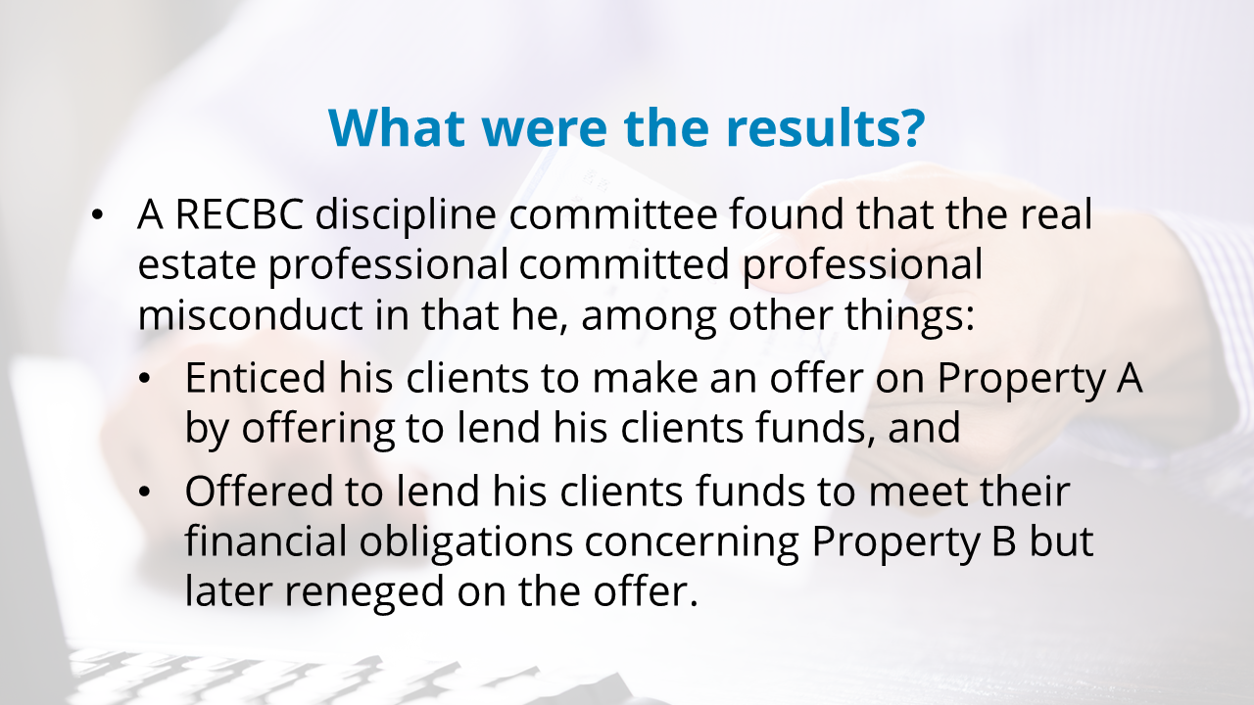
Notes:
A RECBC discipline committee found that the real estate professional’s offer created a conflict of interest.
For example, by offering to lend money to the clients and essentially becoming their creditor, the real estate professional could not impartially carry out his duty to advise them about the benefits and risks of the loan terms, or the absence of loan terms.
A loan would also provide him with remuneration through loan interest and increase his commission should the clients purchase a more expensive property than their original budget allowed.
The real estate professional was found to have committed professional misconduct in that he, among other things:
enticed his clients to make an offer on Property A by offering to lend his clients funds, contrary to ss. 3-3(a) [act in the best interests of the client], 3-3(i) [take reasonable steps to avoid a conflict of interest], 3-3(j) [promptly and fully disclose conflicts of interest to the client], and 3-4 [duty to act honestly and with reasonable care and skill] of the Rules; and
offered to lend his clients funds to meet their financial obligations concerning Property B but later reneged on the offer, contrary to ss 3-3(a) [act in the best interests of the client], 3-3(i) [take reasonable steps to avoid a conflict of interest], 3-3(j) [promptly and fully disclose conflicts of to the client], and 3-4 [act honestly and with reasonable care and skill] of the Rules.

Slide 14

Notes:
What could you do to help identify and reduce risk in this scenario? (open for discussion)

Slide 15
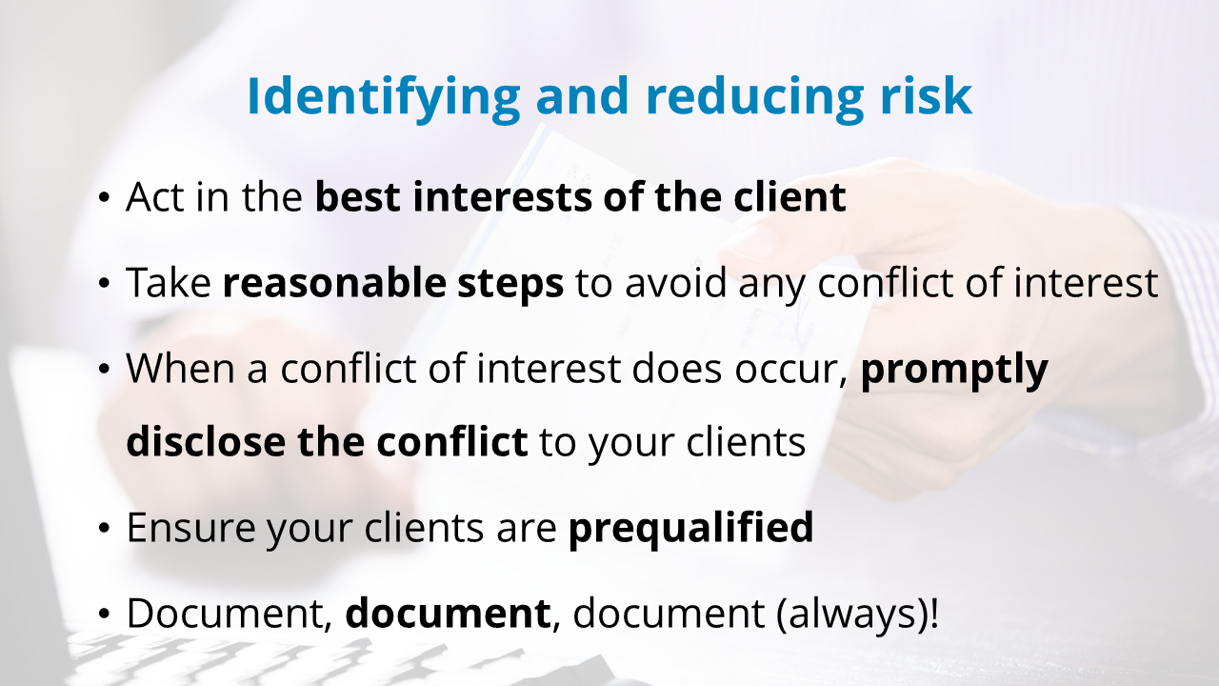
Notes:
Real estate professionals have a duty to avoid conflicts of interest.
As such, being able to identify conflicts that may occur can help guide the actions of a real estate professional.
Real estate professionals must always work in their client's best interest.
In this case, it would have been in the best interests of the clients to find them a property that was within their financial means, rather than offering them a loan to purchase a more expensive property.
It would also be in the best interest of the client to ensure they are prequalified and only making offers on homes they are prequalified for.
To help reduce risk, real estate professionals should always document their actions and the advice provided to their clients.

Slide 16

Notes:
The second case study was provided by the Real Estate Errors & Omissions Insurance Corporation.
In this case study, we will explore a scenario where the buyer is related to the real estate professional representing the seller, thereby creating a conflict of interest.

Slide 17
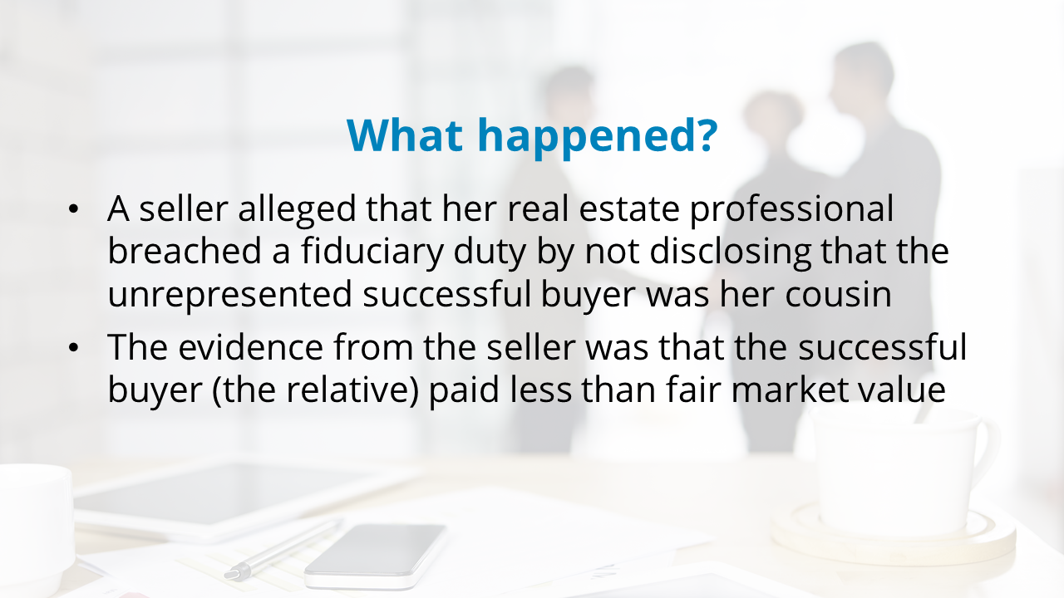
Notes:
In this scenario, a seller alleged that her real estate professional breached a fiduciary duty by not disclosing to her that the unrepresented successful buyer was her cousin.
Although the real estate professional insisted this was widely known by everyone, the seller disputed having such knowledge and asserted there was no written disclosure of the relationship.
Further, the evidence from the seller was that the successful buyer (the relative) paid less than fair market value.

Slide 18

Notes:
So, let’s talk this through. Where did this real estate professional go wrong? (open for discussion)

Slide 19
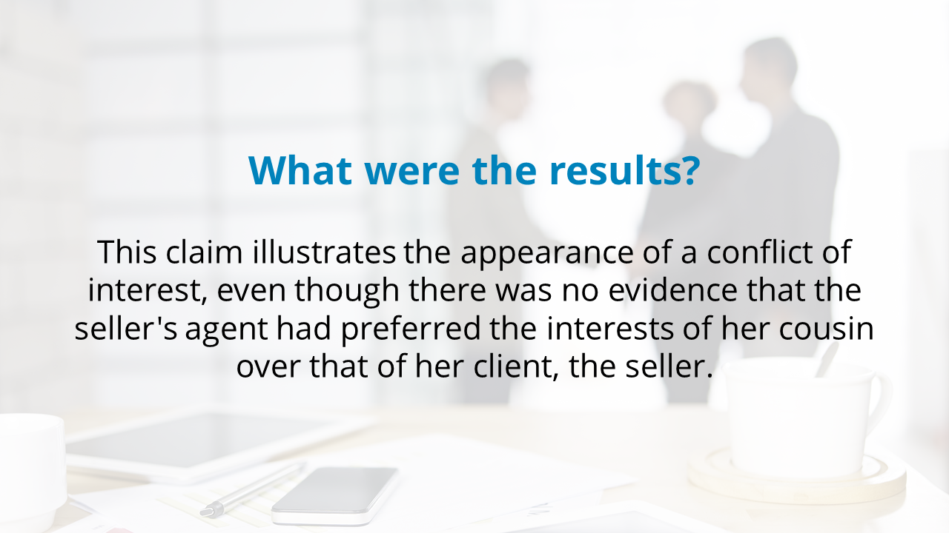
Notes:
This claim illustrates the appearance of a conflict of interest, even though there was no evidence that the seller's agent had preferred the interests of her cousin over that of her client, the seller.
It underscores the role of perception when it comes to conflicts of interest and the importance of documenting disclosures.
While not highlighted here, this situation also involves disclosure requirements as they pertain to material information and disclosure requirements when real estate professionals, associates or family members acquire or dispose of property.

Slide 20

Notes:
How could you identify and reduce risk in this scenario? (open for discussion)

Slide 21
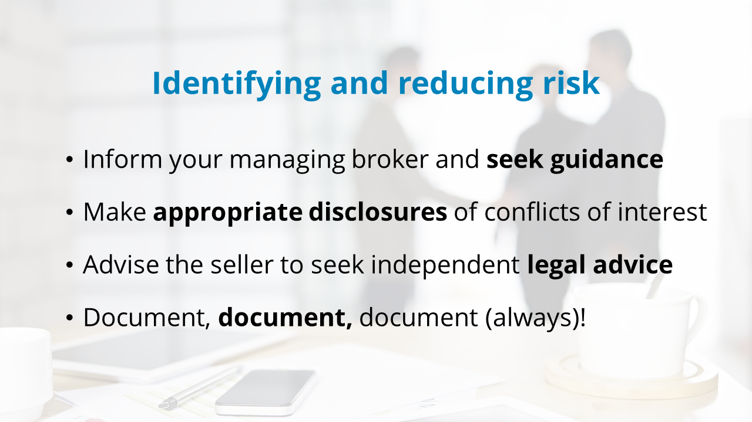
Notes:
Real estate professionals have a duty to avoid conflicts of interest.
As such, being able to identify conflicts that may occur can help guide the actions of a real estate professional.
In this case, the real estate professional should have informed her managing broker and sought guidance to help inform her actions.
Even if the close family member did not fall under the requirements for the real estate professional to complete a Disclosure of Interest in Trade or fall within the broader disclosure requirements under the REALTOR® Code, the real estate professional should have considered disclosing the potential conflict of interest. This information could be material information that would influence the client's decision to sell.
By disclosing the relationship and advising the seller to seek independent legal advice, the seller would have the opportunity to make an informed decision.
The real estate professional could have also mitigated risk by documenting this disclosure.

Slide 22
Notes:
Now that we’ve reviewed two case studies involving conflicts of interest, have these influenced how you feel Dakota should proceed? (open for discussion)

Slide 23
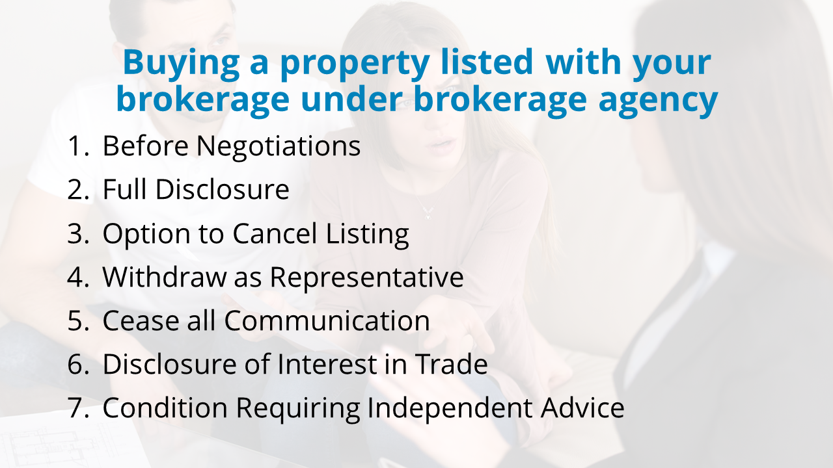
Notes:
To determine how Dakota should proceed in this situation, we first need to acknowledge that there may be different aspects of this scenario that will have an impact on Dakota’s actions.
Dakota should firstly assess the risk, use her professional judgement in informing her actions, and follow the practice guidance from RECBC when buying a property listed with her brokerage under brokerage agency.
If a licensee decides to take a substantial professional risk and make an offer to buy their own listing or, in the case of brokerage agency, any property listed with their brokerage, they are advised as follows by RECBC:
Before Negotiations: Before commencing negotiations with the seller to purchase their property, Dakota should advise her managing broker of her intentions. If her managing broker approves of proceeding with the proposed purchase, she should continue to involve her managing broker or their designate throughout the buying process.
Full Disclosure: Dakota should promptly and fully disclose the conflict of interest to the seller as summarized above and confirm such disclosure in writing.
Option to Cancel Listing: Dakota’s team should give the seller the option to cancel the service agreement (listing) and the opportunity to seek independent representation.
Withdraw as Representative: If the seller chooses not to cancel the service agreement, the brokerage representative acting for the seller should fully withdraw, with the managing broker or their designate then undertaking to act as an alternate representative of the brokerage when dealing with the seller.
Cease All Communication: Dakota and her team members should cease all direct communication with the seller. All contact with the seller should be indirectly through her managing broker or their designate.
Disclosure of Interest in Trade: Dakota should ensure that the disclosure is documented and presented to the seller, before the presentation of her offer. A clause should be included in the contract confirming delivery of the required disclosure.
Condition Requiring Independent Advice: Dakota should make her offer subject to the Seller, on or before [a specific date which should ensure sufficient time is provided for the seller to obtain all required professional advice], receiving and being satisfied with such professional advice as they deem appropriate, including but not limited to legal advice as to the terms and conditions of this Contract, appraisal advice as to the current fair market value of the Property and tax advice.

Slide 24
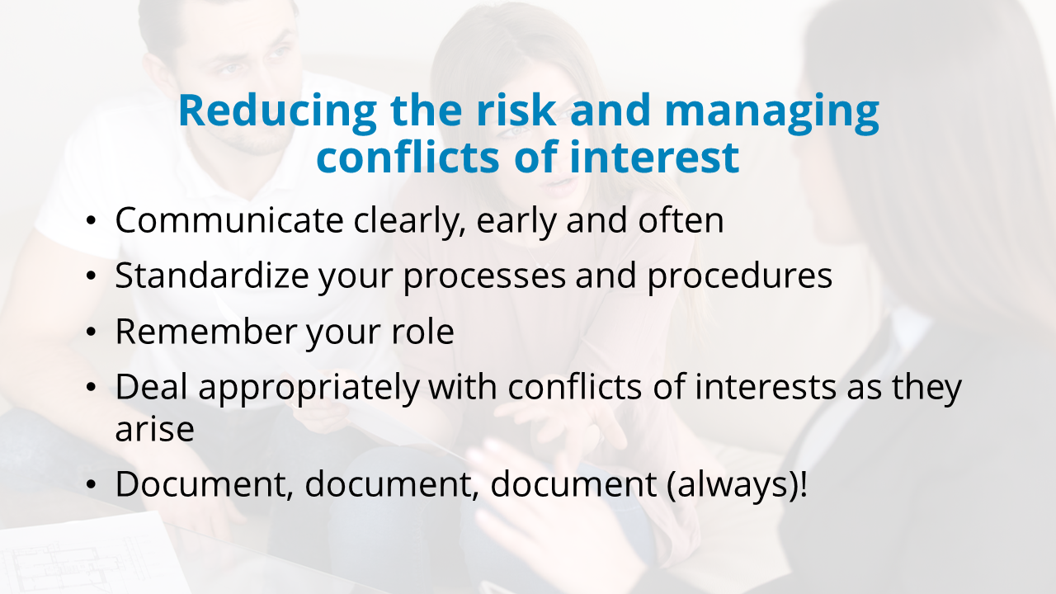
Notes:
While there are different types of conflicts of interest a real estate professional may face, here are a few proactive steps you can take to avoid conflicts of interests:
Communicate clearly, early and often: Before you begin working for a client, clearly describe your duties, obligations and the scope of the services you will be providing. Discuss the types of conflicts that may arise and options on how you and your client may resolve them. Let the client know what your obligations are under the Act, Rules and Regulations.
Standardize your processes and procedures: Run your business like a business. Mistakes and poor or untimely communications occur when things get busy and crucial steps are missed. Standardized processes and checklists can help ensure that this does not happen to you.
Remember your role: You are a trusted advisor with special expertise. You must always act in your client’s best interest, taking reasonable steps to avoid any conflicts of interest. If a conflict does arise, you must promptly and fully disclose it to the client.
Deal appropriately with conflicts of interests as they arise: Unanticipated conflicts of interest can arise. Where a conflict of interests arises that cannot be reasonably avoided, ensure you promptly and fully disclose the conflict to the client. You should also ensure you seek guidance from your managing broker.
Document, document, document (always)!

Slide 25

BCREA Legally Speaking #517: https://www.bcrea.bc.ca/legally-speaking/the-first-law-of-holes-517/
REEOIC & RECBC Podcast on Conflicts of Interest: https://www.recbc.ca/professionals/knowledge-base/articles/managing-conflicts-interest
RECBC: https://www.recbc.ca/professionals/knowledge-base/guidelines/trading-services#conflicts-of-interest
Notes:
While this presentation considers different perspectives on how real estate professionals may address situations to avoid acting outside their area of expertise, it’s important to refer to these resources to help ensure compliance to practice.
Thank you!

